Slide 1

PIXIS INSIGHTS CASE STUDY ASSIGNMENT
SUBMITTED BY: AMARTYA MAJUMDER

Slide 2

Client Brand: Flipkart
Competitors:
Amazon
Bulbul
Flipkart
Glowroad
Meesho
Myntra
Shop 101
Snapdeal
Objective:
To interpret the data from the lens of client brand (competition, cohort performance etc) and summarise the key takeouts

Slide 3
Which of these products have you purchased in the last 6 months?
Product Purchased by AGE GROUP
Product Purchased by Gender
Analysis: According to Flipkart, 61% of the respondents purchased Personal care products, following that Beaty products have been purchased by 59% respondents, Accessories such as watches, sunglasses, Socks, Belts, Hair accessories, etc. Majority of 66%(880 respondents) were in the age group of 25-34 and 66%(312 respondents) were in 35-45

Slide 4
When you think of online shopping platforms , which is the first name that comes to your mind?
Analysis: Out of 1244 respondents, Flipkart’s brand positioning is the best among all competitors, where 880 or 71% respondents vote for the brand Flipkart that comes to their mind when they think about online shopping platforms followed by Myntra of 151 or 12% respondents.
Brand | Age |  |  | Gender
 | 18-24 | 25-34 | 35-45 | female | male
flipkart | 34% | 25% | 26% | 26% | 32%
Online Shopping Platforms | Number of Respondents | Percentage
Bulbul | 0 | 0%
Flipkart | 880.15 | 71%
Glowroad | 0 | 0%
Meesho | 60.7 | 5%
Myntra | 151.75 | 12%
Others | 91.05 | 7%
Shop 101 | 0 | 0%
Snapdeal | 60.7 | 5%
Total | 1244 | 100%
Flipkart is mostly recognized by Males who are in the age group of 18-24 years

Slide 5
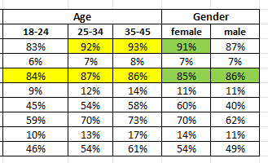
Select all the brands that you are aware of from the list.
Analysis: According to total of 3035 respondents, Amazon is leading the market where it is known by 89% of the respondents following by Flipkart’s 86%. Amazon is Flipkart’s primary and closest competitors, both the brands have quite a good brand awareness. Myntra is also following the giants with a good awareness rate of 66%, then followed by Snapdeal and Meesho (52% and 51%)
Flipkart & Amazon
Amazon is mostly known by people of age group 25-45, where as Flipkart is equally present among all age groups.
Products are mostly bought by female in amazon but both male and female buys from flipkart.
Select all the brands that you are aware of from the list. | Percentage
Amazon | 89%
Bulbul | 7%
Flipkart | 86%
Glowroad | 11%
Meesho | 51%
Myntra | 66%
Shop 101 | 13%
Snapdeal | 52%

Slide 6
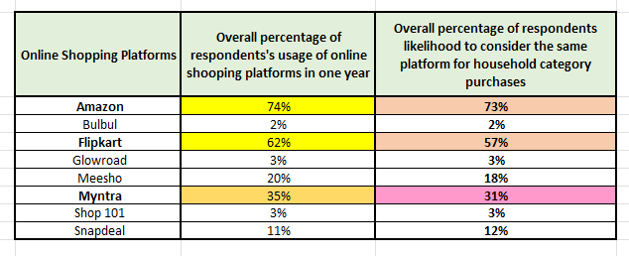
Online Platforms consideration for next purchase in case of Household Category
Online Platforms used last year
Correlation between platform usage and likelihood to consider the same platforms for household purchases.
To understand the data given for the usage of platforms last year and the likelihood to consider the same platforms for household purchases. Correlation was checked to determine how correlated is the usage of platforms to the likeliness of purchasing household products Analysis: It is positively correlated and almost a perfect correlation, so we can say that the usage of the platforms is highly correlated to likeliness of purchasing. Flipkart should focus on engagement.
Note: People mostly prefer Amazon for online purchase of household category

Slide 7
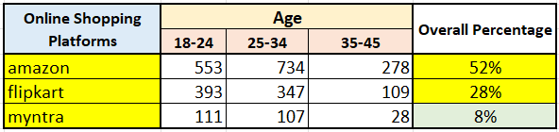
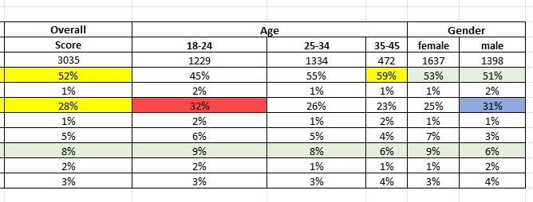
Frequency of using any online platforms
Analysis: According to the table, we have picked the top three online shopping platforms where Amazon is leading with 52% of the respondents visits Amazon, then comes Flipkart with 28% and a minor amount of people visit Myntra. Flipkart maintains a good number of visitors in the age group of 18-24, and a decent amount in 25-34 years.
Denoted, we can say Flipkart have more appeal in the young to middle aged people group, still they are behind amazon in every aspect. But are way ahead of myntra.

Slide 8

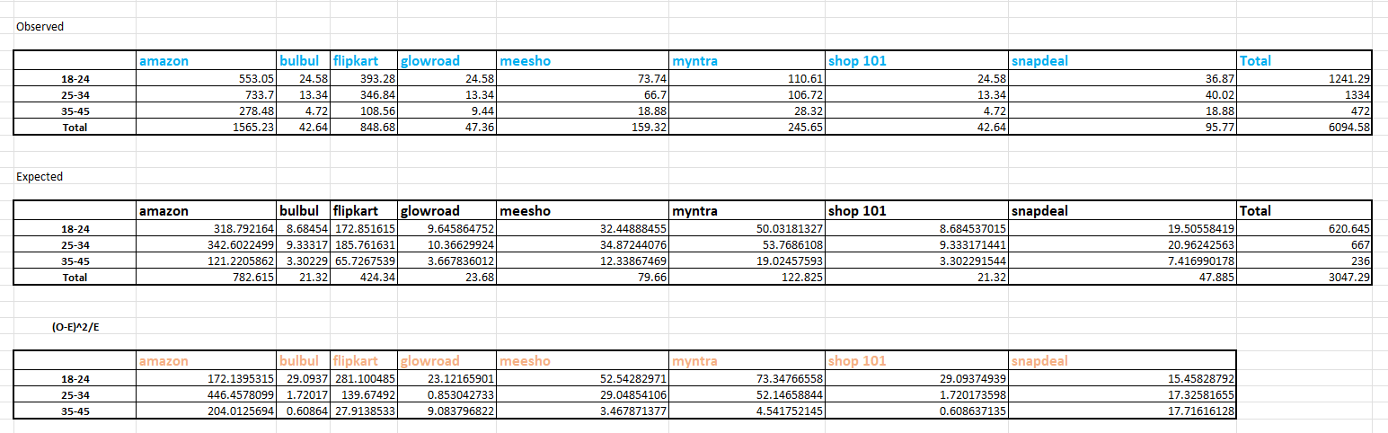
Frequency of using any online platform
Chi – Square Test for Age group and Platform usage
Analysis: As the P value is less that 0.05, which is the point of significance, we can reject the null hypothesis and accept the alternate hypothesis.
That means there is a significant relation between age and platform usage frequency
Ho: There is no relationship between age group and the most frequently used platform
Ha: There is a significant relationship between age group and the most frequently used platform

Slide 9
Brand Association of Competitor Brands
Brand Association | Meesho | Amazon | Myntra
Is a trusted platform for shopping | 55% | 82% | 64%
Brand Association | Snapdeal | Glowroad | Bulbul
Offers a good range of products | 49% | 51% | 50%
Analysis: 82% respondents who shop from Amazon shops due to it is a trusted platform, following Myntra and Meesho these are the brands customer trust. Flipkart is also associated for that.
Brands like Snapdeal, Glowroad, Bulbul, on an average of 50% people associates these brands through wide range of products.
Note: Flipkart should be believed as trusted, and they should have a wide range of products that make their sustainable competitive advantage

Slide 10
Watched the Ad?
People sees the Ad on which platform
Where have you seen the Ad? | female | male
Heard about it from Social Media Influencers/Bloggers | 18% | 18%
Heard from friends/ relatives | 15% | 15%
OTT Platforms( Hotstar, sony liv, zee 5, etc) | 24% | 26%
Outdoor Hoardings and Banners | 7% | 9%
Print advertisement | 8% | 10%
Read an article in a newspaper or magazine | 11% | 10%
Read in an article online | 13% | 14%
Saw this on Facebook/ Instagram | 32% | 30%
TV | 57% | 51%
Youtube | 67% | 68%
Out of 1340 respondents, 82% of the female respondents watched the ad and out of 1106 respondents, 79% of the male respondents have seen the ad
Mainly the Ad is seen by the respondents whether be male or female, it is through TV, YouTube, Facebook Instagram, which constitutes 30%-70%..rest are from OTT and other platforms
Flipkart should run more ads on YouTube through Google, then run TV ads that would connect the upper age group people and rest can be pushed through OTT platforms to leverage their reach and conversions.

Slide 11
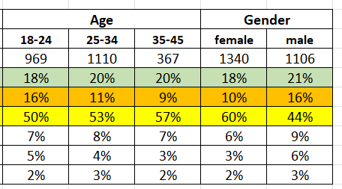
Brand Association with the Ad
Analysis: The Ad is mostly associated to Meesho who is having a 52% respondents who feels Meesho is associated to it.
Mostly female respondents (60%) associated themselves with Brand Association.
Note: Flipkart should make an ad that would connect the customers on trust and their value proposition

Slide 12
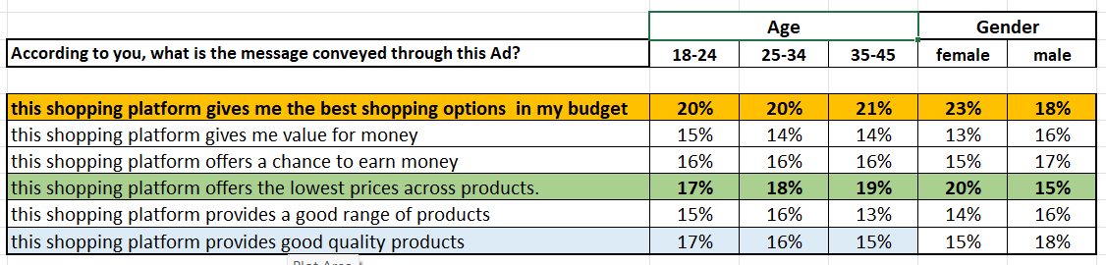
Message Conveyed through AD?
Do you agree with the message conveyed in this ad?
No of respondents : 2446
Analysis: Majority of 17% to 20% respondents think that the platform gives best budget friendly shopping options also offers lowest price across products. Mostly 20% to 23% respondents were female who felt it. Flipkart should consider variety of products with competitive low- price strategy.
Analysis: The message which was conveyed on the ad on best budget friendly shopping and lowest price, it is on a majority of 45% agreed (age group of 18-24), the respondents who strongly agreed were in the age group of 35-45 years which was of 42%

Slide 13
Recommendations for Flipkart
1. Build Trust: Highlight reliability and security in communications so that they can compete with Amazon’s trust factor (82% of the respondents buys products on Amazon because of Trust)
2. Expansion in Product Range and Competitive Price Setting
Increase offerings in high demanded products as per data “personal care, beauty and accessories)
Low price strategy
3. Work on Google Ads and Television promotion , social media ads
Prioritize YouTube, Instagram, and Facebook for younger audiences (18-24).
Use TV ads for older segments (35-45) and OTT platforms to reach broader demographics.
4. Gender-Specific Marketing
Create campaigns targeting female shoppers, focusing on beauty and apparel collections.

Slide 14

Thank You

